Slide 1

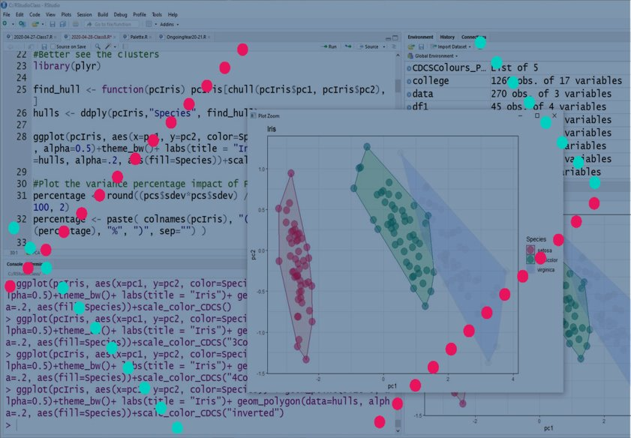
Finding Patterns in Data
Case Study: Diversity Indices
jpage3@ed.ac.uk

Slide 2
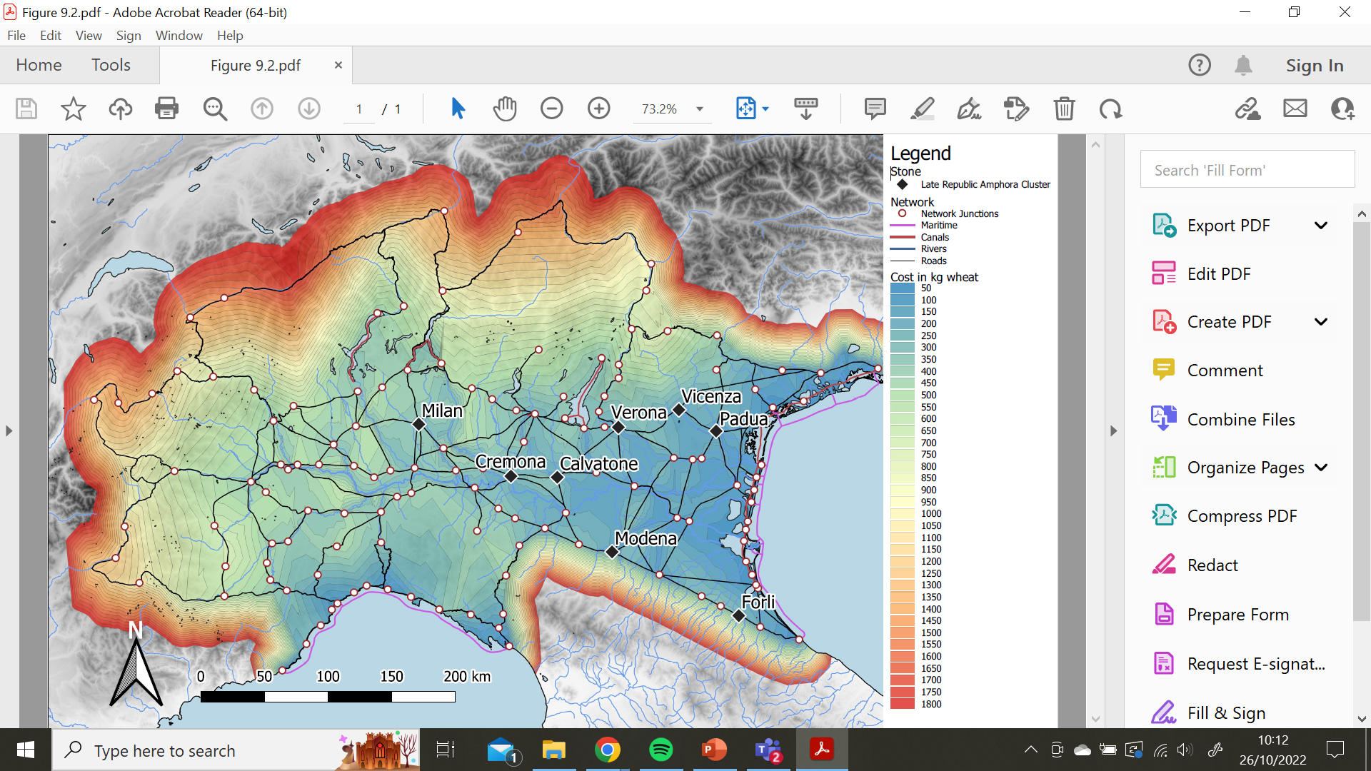

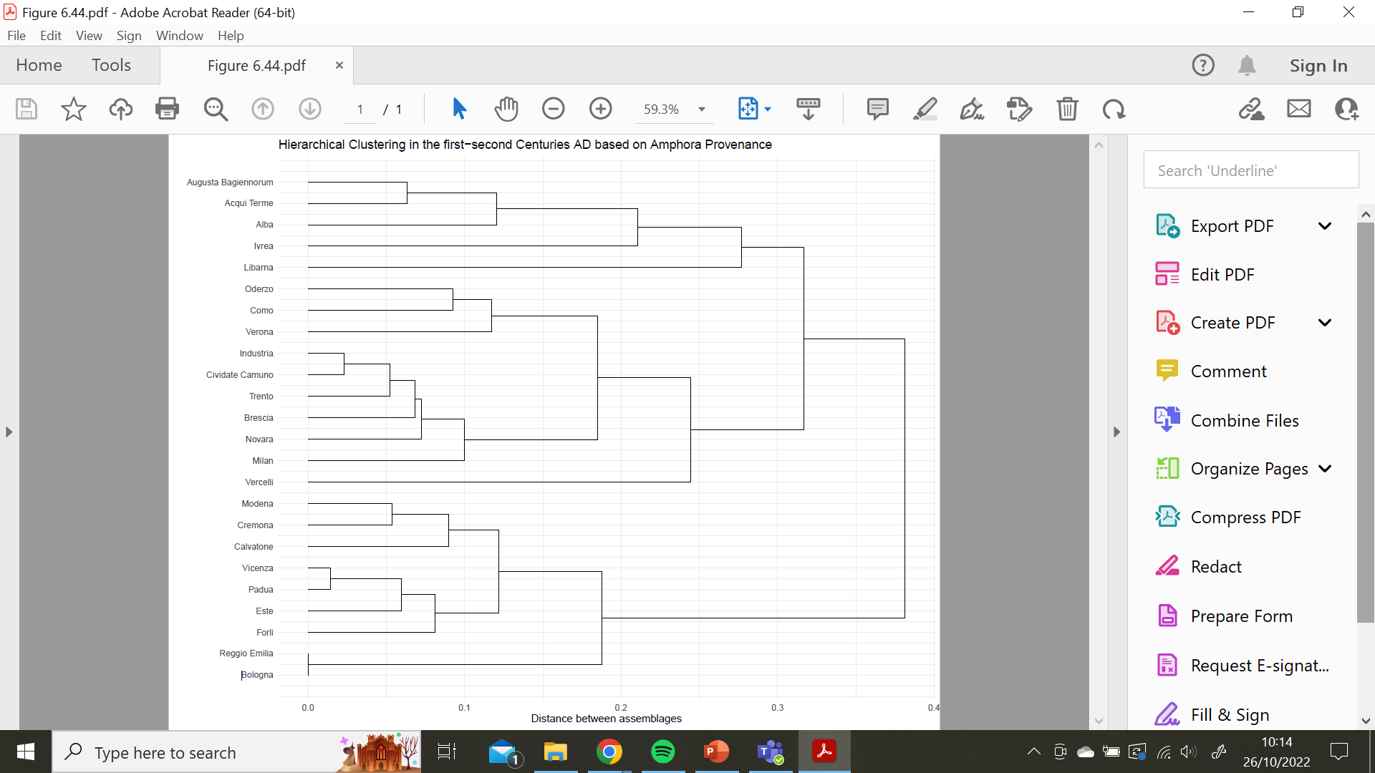
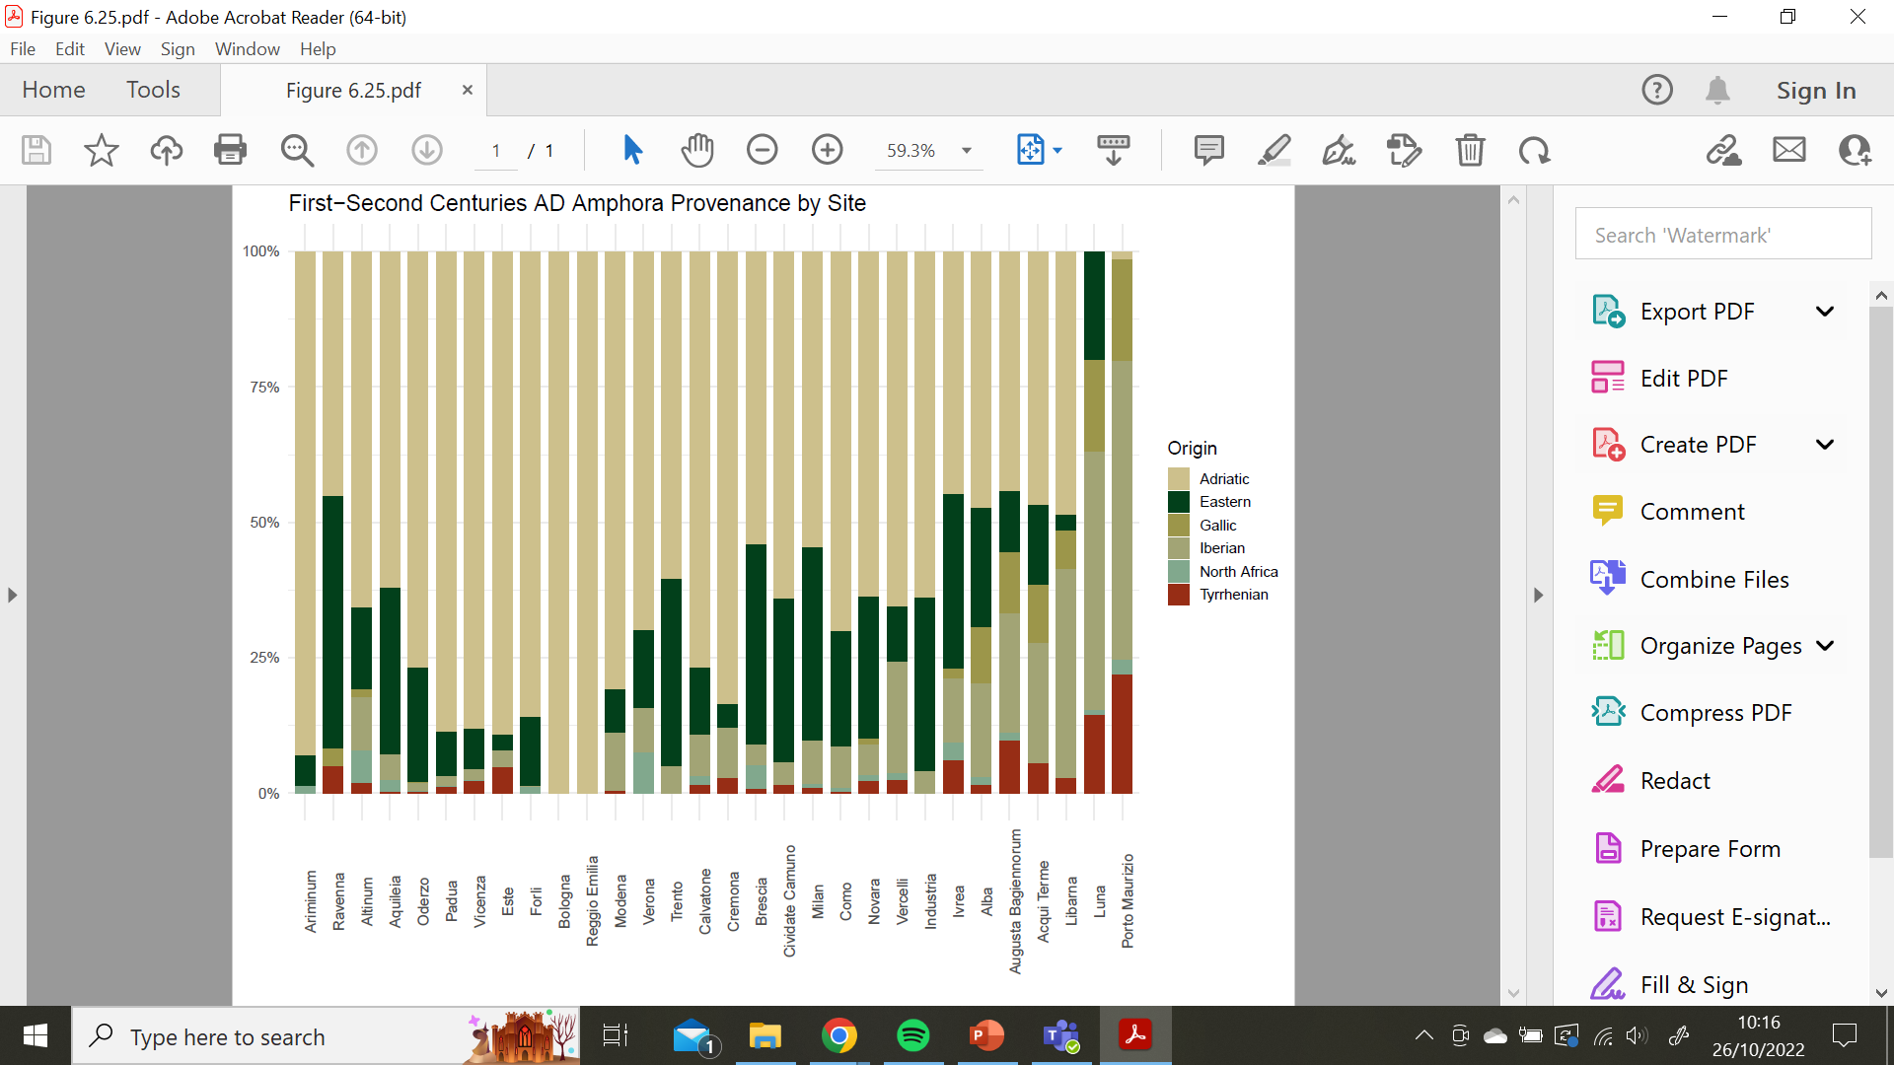
Before starting …
Who am I
I obtained a PhD in Classics from the University of Edinburgh.
Digital Training Fellow with the CDCS

Slide 3
Today’s Program
Statistics and what test to pick?
The importance of sample size
Case Study: Diversity Indicies
Simpson’s Index
Jaccard’s Similarity Coefficient
Morisita-Horn Overlap Coefficient

Slide 4



Statistics
Key Info:
A broad field.
Impossible to be an expert in everything.
It is important to have a clear research question (and an idea of the expected result), alongside a good understanding of your data.
Knowing which test to use can depend on a number of things.
The purpose of your analysis.
What you want to do with your data.
What measurement level your variables are.
https://www.scribbr.com/statistics/statistical-tests/
https://methods.sagepub.com/which-stats-test
www.cdcs.ed.ac.uk

Slide 5
Sample Size
Key Info:
Your sample is the data you will be analysing.
Sampling is often a proxy.
It’s impossible to include every piece of data. Your sample will almost always be reprenstative, rather than a complete dataset.
The law of large numbers, in probability and statistics, states that as a sample size grows, its mean gets closer to the average of the whole population. This is due to the sample being more representative of the population as the sample become larger.
www.cdcs.ed.ac.uk

Slide 6
Sample Size: Exercise
Sample Size and Distribution:
Let’s explore how distribution changes with sample size.
Download and load the file sheeps.csv into R Studio. It contains femur lengths measurements for sheep found on 2 different farms. These neolithic farms have an awesome archaeological record as fieldwork was able to recover measures for 500 sheeps on each of the sites. Let’s take a look at the data using ggplot.
Code:
ggplot(sheeps, aes(x=value, fill=id)) + geom_density(alpha=0.5)
www.cdcs.ed.ac.uk

Slide 7
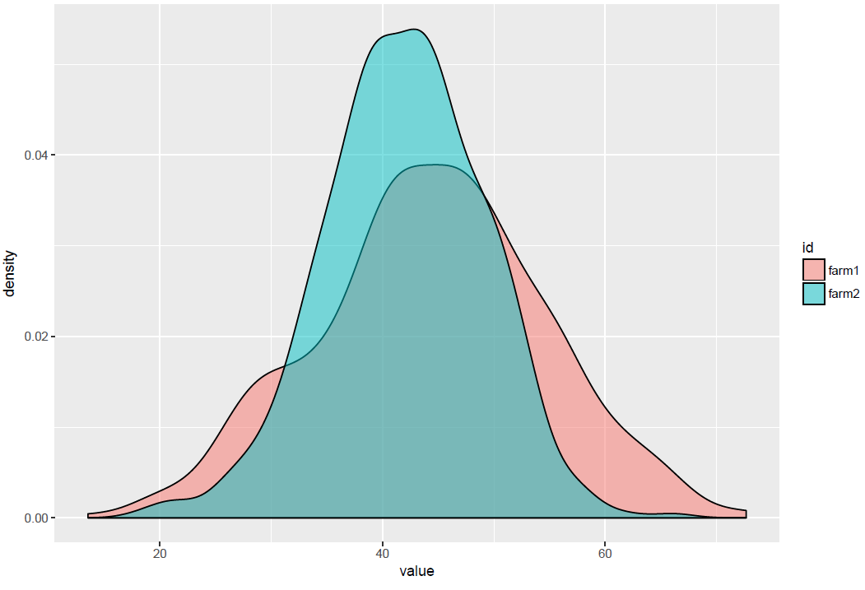
Sample Size: Exercise
As you can see the sample of each site roughly follows a normal distribution with slightly different mean and standard deviations.
Will this change is we subsample our dataset?
The idea is to select only a part of the entire sample and see if we have the same mean and standard deviation than before.
www.cdcs.ed.ac.uk

Slide 8
Sample Size: Exercise
Use the sample function from the library dplyr to take a series of sub-samples from the dataset. Plot these subsamples using ggplot and compare the distribution. How does it change?
Code:
sample500 <- sample_n(sheeps, 500)
sample50 <- sample_n(sample500, 50)
sample10 <- sample_n(sample50, 10)
sheeps$sampleSize <- 1000
sample500$sampleSize <- 500
sample50$sampleSize <- 50
sample10$sampleSize <- 10
samples <- rbind(sheeps, sample500, sample50, sample10)
ggplot(samples, aes(x=value, fill=id)) + geom_density(alpha=0.5) + facet_grid(~sampleSize)
www.cdcs.ed.ac.uk

Slide 9
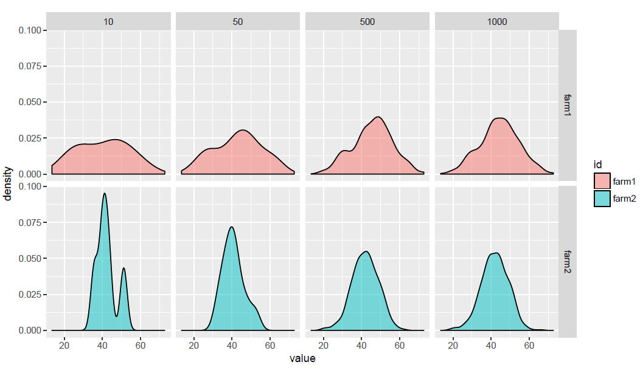
Sample Size: Exercise
What is the impact of sampling on the representativeness of the dataset?
What sample size would you choose as a minimum for a decent analysis?
www.cdcs.ed.ac.uk

Slide 10
Sample Size
As higlighted, a perfect sample would be a random sample.
However, several processes can bias the randomness of samples.
Frequency bias
Survivorship bias
Intensity bias
www.cdcs.ed.ac.uk

Slide 11
Sample Size: Frequency Bias
It is possible some things will be over-represented in the sample.
For example, taphonomic processes affect the frequency distribution of artifacts.
Small things are most prone to disappear or to be discarded within archaeological research
Sites
Bones
Pottery shards
www.cdcs.ed.ac.uk

Slide 12
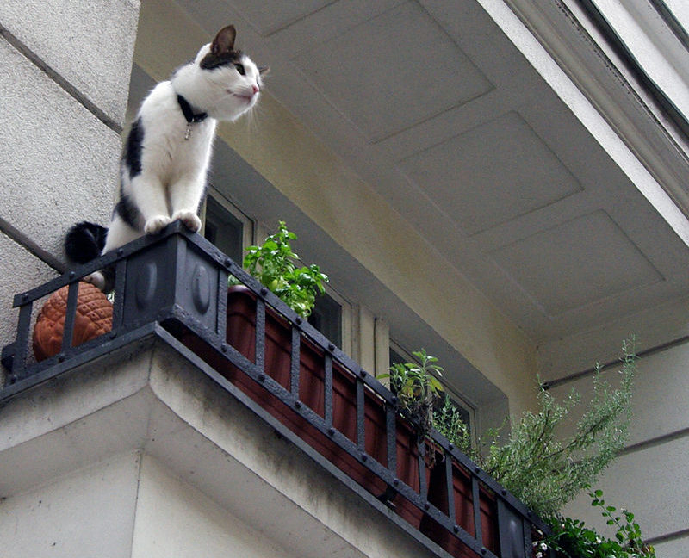
Sample Size: Survivorship Bias
“cats who fall from less than six stories, and are still alive, have greater injuries than cats who fall from higher than six stories.”
“this might happen because cats reach terminal velocity after righting themselves at about five stories”
It could also happen that most of them die
Whitney, W. O., and C. J. Mehlhaff. "High-rise syndrome in cats." Journal of the American Veterinary Medical Association 191.11 (1987): 1399-1403.
www.cdcs.ed.ac.uk

Slide 13
Sample Size: Intensity Bias
www.cdcs.ed.ac.uk

Slide 14
Sample Size
Our samples are typically not random
Biases can be unrelated to our research questions
We can compare equally biased samples
Difference between samples can be more relevant than biases
www.cdcs.ed.ac.uk

Slide 15
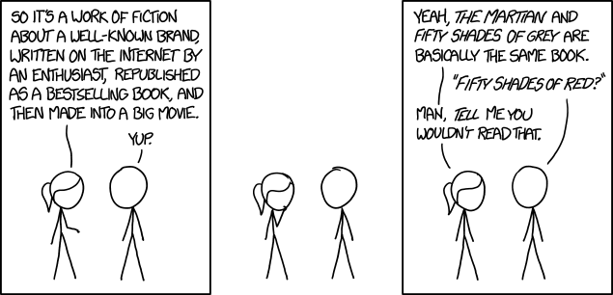
Indexes of Similarity and Differences
What do you need:
A series of samples (e.g. a series of ecosystems: area 1 area 2, area 3 etc..)
Within each sample a series of categorical variables (e.g. the animals present in the area: wolves, caws, cats, deers etc)
A continous variable associated to the previous (e.g. number of animals attested for each species)
When I have a series of samples and I want to compare them. How can I determine how much the sample are similar and how much are different
https://imgs.xkcd.com/comics/similarities.png
Concepts
Richness: n of classes
Evenness: relative abundance of classes
Diversity: number of different classes found
Similarity: amount of overlap found
www.cdcs.ed.ac.uk

Slide 16
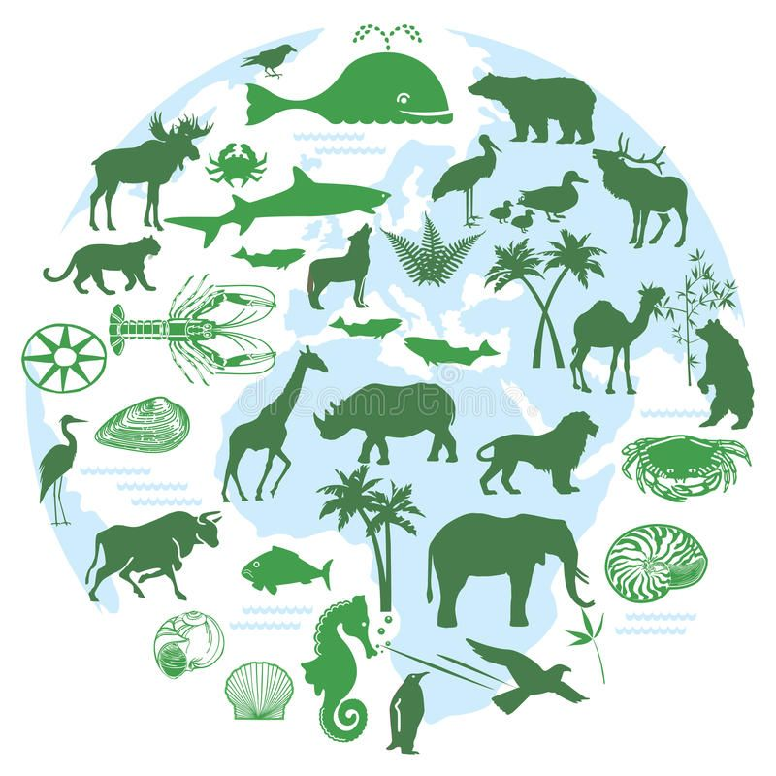
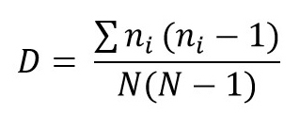
Simpson’s Diversity Index
Used mainly in ecology
N= total number of individual for all species
n= number of individual per species
How to read the results
0 = all observations belong to 1 category (only one animal there)
1 = max diversity available
0% chances that 2 observed records belong to 2 different categories
100% chances that 2 observerd records belong to 2 different categories
https://www.dreamstime.com/royalty-free-stock-image-animals-biodiversity-image28900966#res26615551
https://www.youtube.com/watch?v=8dYSvo8EqFE
www.cdcs.ed.ac.uk

Slide 17
Simpson’s Index: Exercise
Calculating Simpson’s Index:
Let’s create a presense/absence table and calculate Simpson’s Index for each site.
Let’s move to a different area...download and load the file animals.csv into R Studio. It contains the count of different animal species for 6 different sites: 3 from Late Bronze Age and 3 from Early Iron Age. We want to assess if the diversity of domesticated species was constant over time or change during these 2 periods. This type of information will allow us know if environmental or cultural factors could have affected subsistence strategies of the peoples that populated the area.
Code:
animalsMatrix <- acast(animals, id~species, value.var="values")
animalsMatrix
diversity(animalsMatrix, index="simpson")
www.cdcs.ed.ac.uk

Slide 18
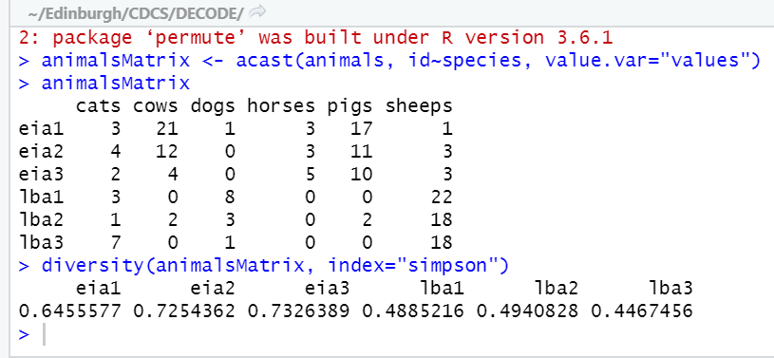
Simpson’s Index: Exercise
The function acast transform a dataframe (animals to a matrix; we have told it that the columns id and species will be the rows/columns of the matrix and the value for each cell will be drawn from the column values.
As you remember the Simpson index goes from 0 (only 1 species) to 1 (each species equally distributed).
What period has the highest Simpson’s index on average?
www.cdcs.ed.ac.uk

Slide 19
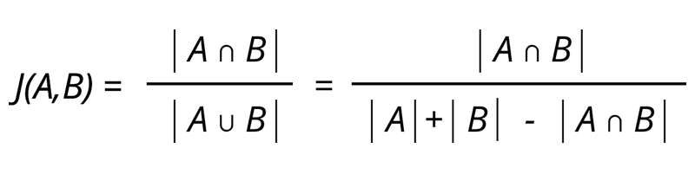
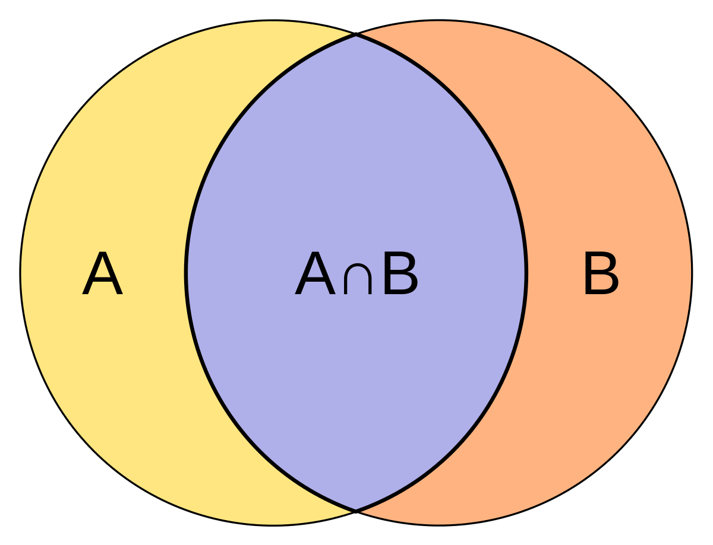
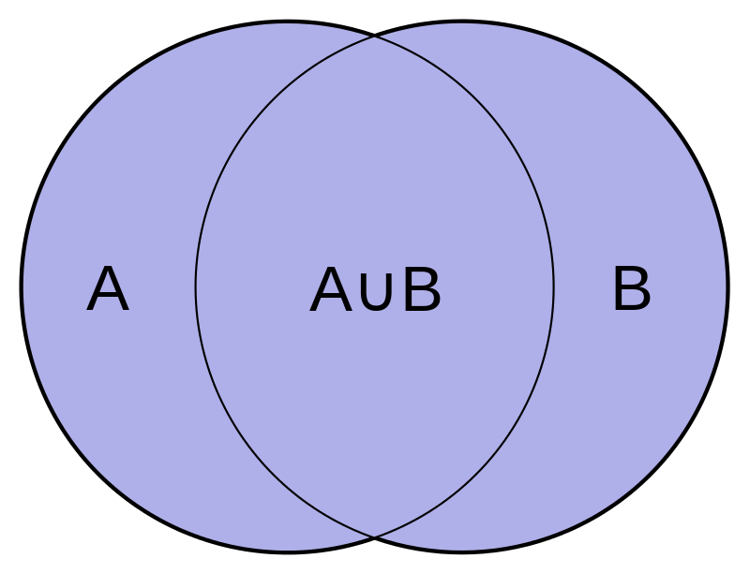
Jaccard Coefficient of Similarity
Index based on the presence/absence of a category
0: the 2 groups are completely different
1: the 2 groups are identical
Does not take into account the eveness of the classes
NB when we compute in R studio we are checking the distance hence the 2 identical group are 0
www.cdcs.ed.ac.uk

Slide 20
Jaccard’s Coefficient: Exercise
Calculating Jaccard’s Coefficient:
Let’s examine which species are present at each site.
Next, create a presense/absence table and calculate Jaccard’s Coefficient for each site.
Simpson’s index gives you a general perspective on the diversity of each site. However, we would also like to know what sites have similar species than other ones...first, we can visualize what species are present on each site, before calculating which Jaccard’s Coeffcient for each.
Code:
ggplot(animals, aes(x=id, y=values, fill=species)) + geom_bar(stat="identity") + facet_wrap(~period, scales="free_x")
vegdist(animalsMatrix, method="jaccard", binary=TRUE)
www.cdcs.ed.ac.uk

Slide 21
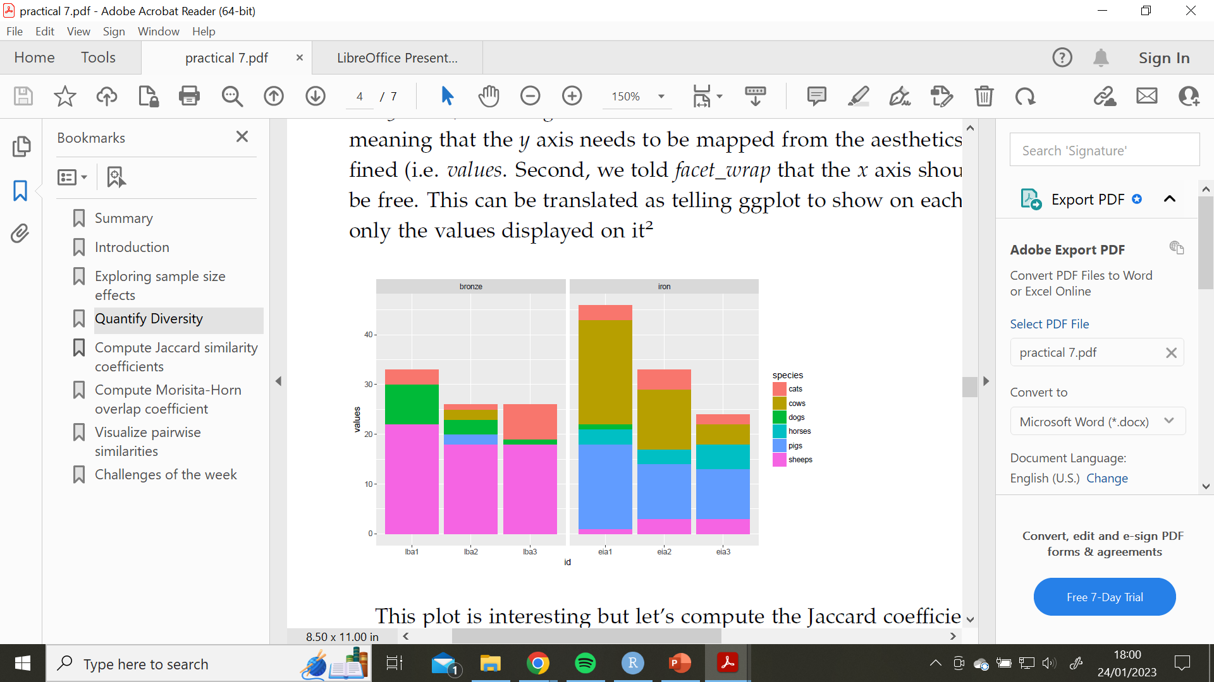
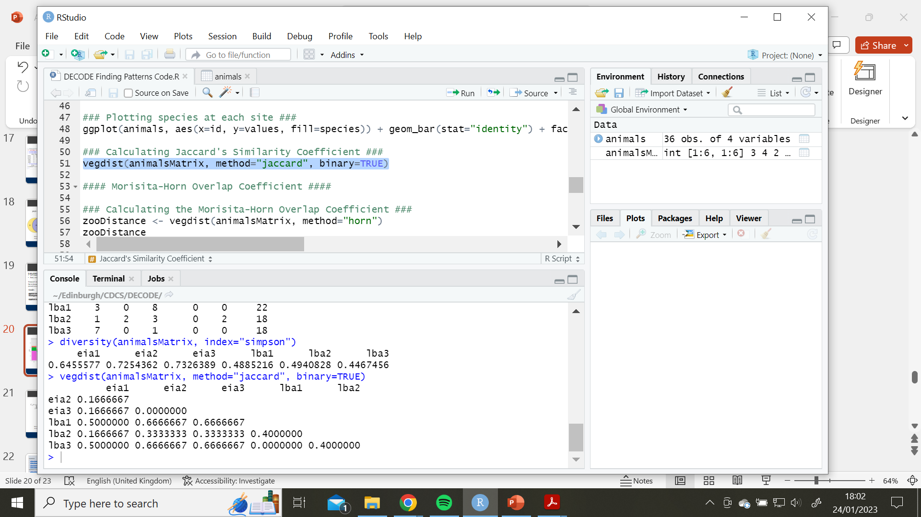
Jaccard’s Coefficient: Exercise
As you can tell we specified Jaccard as the method as the function provides a bunch of different distances.
Jaccard required binary data so we also tell the function to regularize the data to binary (TRUE/FALSE) values before computing the distance.
What sites share a higher percentage of species?
www.cdcs.ed.ac.uk

Slide 22
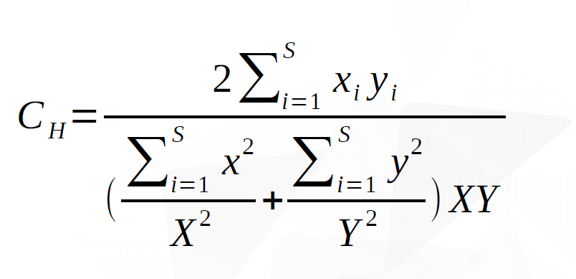
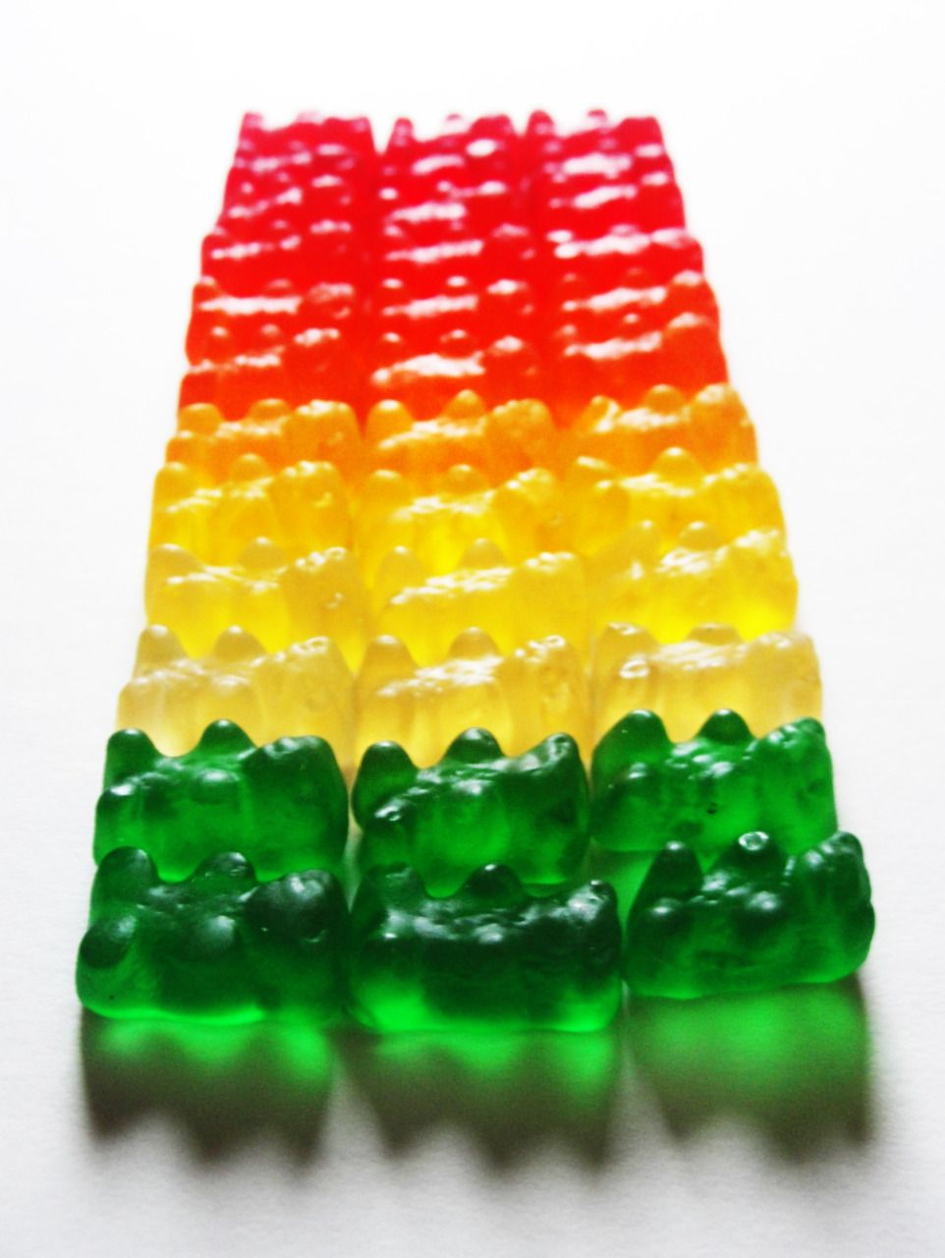
Morisita-Horn Coefficient of Similarity
Similar principle of the Jaccard but it will also take into consideration the frequency of every group present (eveness of classes)
S=total number of classes
NB when we compute in R studio we are checking the distance hence the 2 identical group are 0
www.cdcs.ed.ac.uk

Slide 23
Moristia-Horn: Exercise
Calculating Morisita Horn’s Coefficient:
Let’s create a presense/absence table and calculate Morisita-Horn Coefficient for each site.
The Jaccard distance only takes into account presence/absence of groups; this is interesting but as we saw in the plot some species (i.e. sheeps, pigs) are way more frequent than the rest. We can take this into account using a similarity index that takes into account the abundance of each species. One of the most popular ones is the Morisita-Horn overlap index:
Code:
zooDistance <- vegdist(animalsMatrix, method="horn")
zooDistance
www.cdcs.ed.ac.uk

Slide 24
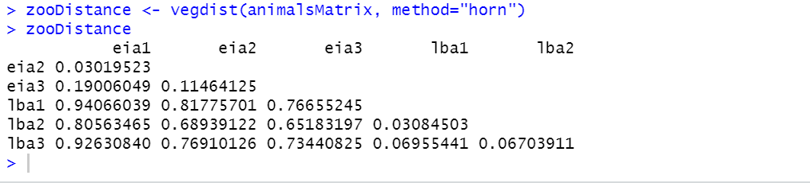
Morisita-Horn: Exercise
Are these similarity measures similar to the Jaccard ones? Are there any big differences?
www.cdcs.ed.ac.uk

Slide 25
Visualizing Pairwise Distances: Exercise
Visualising Data:
Let’s explore some ways of plotting our results from the similarity indicies.
Printing the output in the control panel works here because he just have 6 sites...but how would you analyse a sample of 200 species on 163 different sites? We need some help from information visualization techniques. To start with, let’s display the output of the Morisita-Horn Overlap Coefficient as a raster:
Code:
zooDistanceMatrix <- as.matrix(zooDistance)
zoo <- melt(zooDistanceMatrix, varnames=c("site1", "site2"), value.name="distance")
ggplot(zoo, aes(x=site1, y=site2, fill=distance)) + geom_raster()
ggplot(zoo, aes(x=site1, y=site2, fill=distance, label=round(distance, 2))) + geom_raster() + geom_text(color="white")
www.cdcs.ed.ac.uk

Slide 26
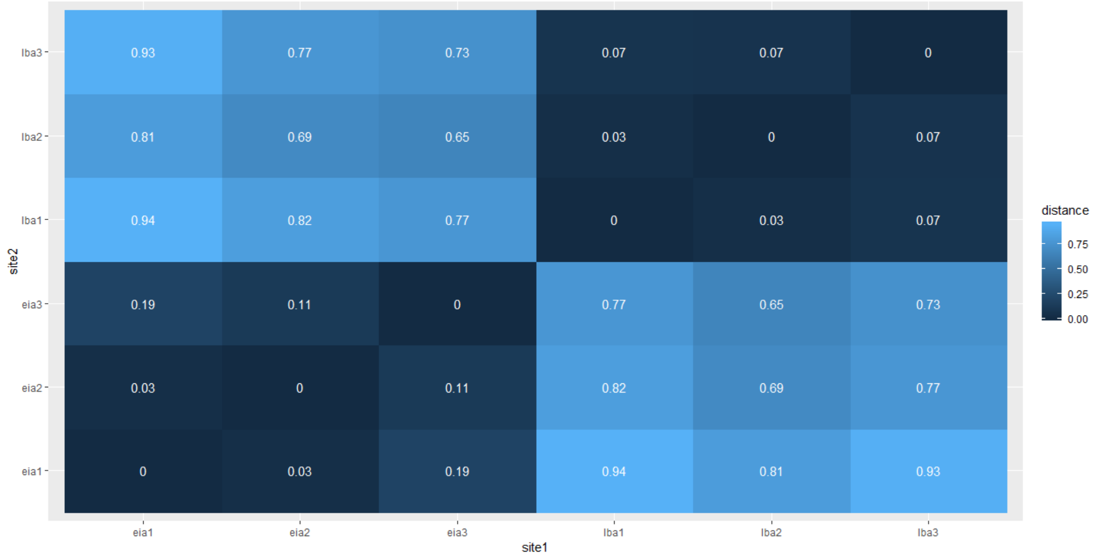
Visualizing Pairwise Distances: Exercise
Plotting the results as a raster helps to better visualize the clear patterns in the data.
www.cdcs.ed.ac.uk

Slide 27
Visualizing Pairwise Distances: Exercise
Visualising Data:
Let’s explore some ways of plotting our results from the similarity indicies.
Rasters form a good way of visualizing results from diversity indices. However, there are other ways we could approach this. Next, let’s try displaying the results as a dendrogram:
Code:
morisitaHClust <- hclust(zooDistance, method="average")
ggdendrogram(morisitaHClust, rotate=T) + labs(title="Animal Similarity Between Sites Using Morisita-Horn Overlap Coefficient", x="", y="Distance between assemblages") + theme_minimal()
www.cdcs.ed.ac.uk

Slide 28
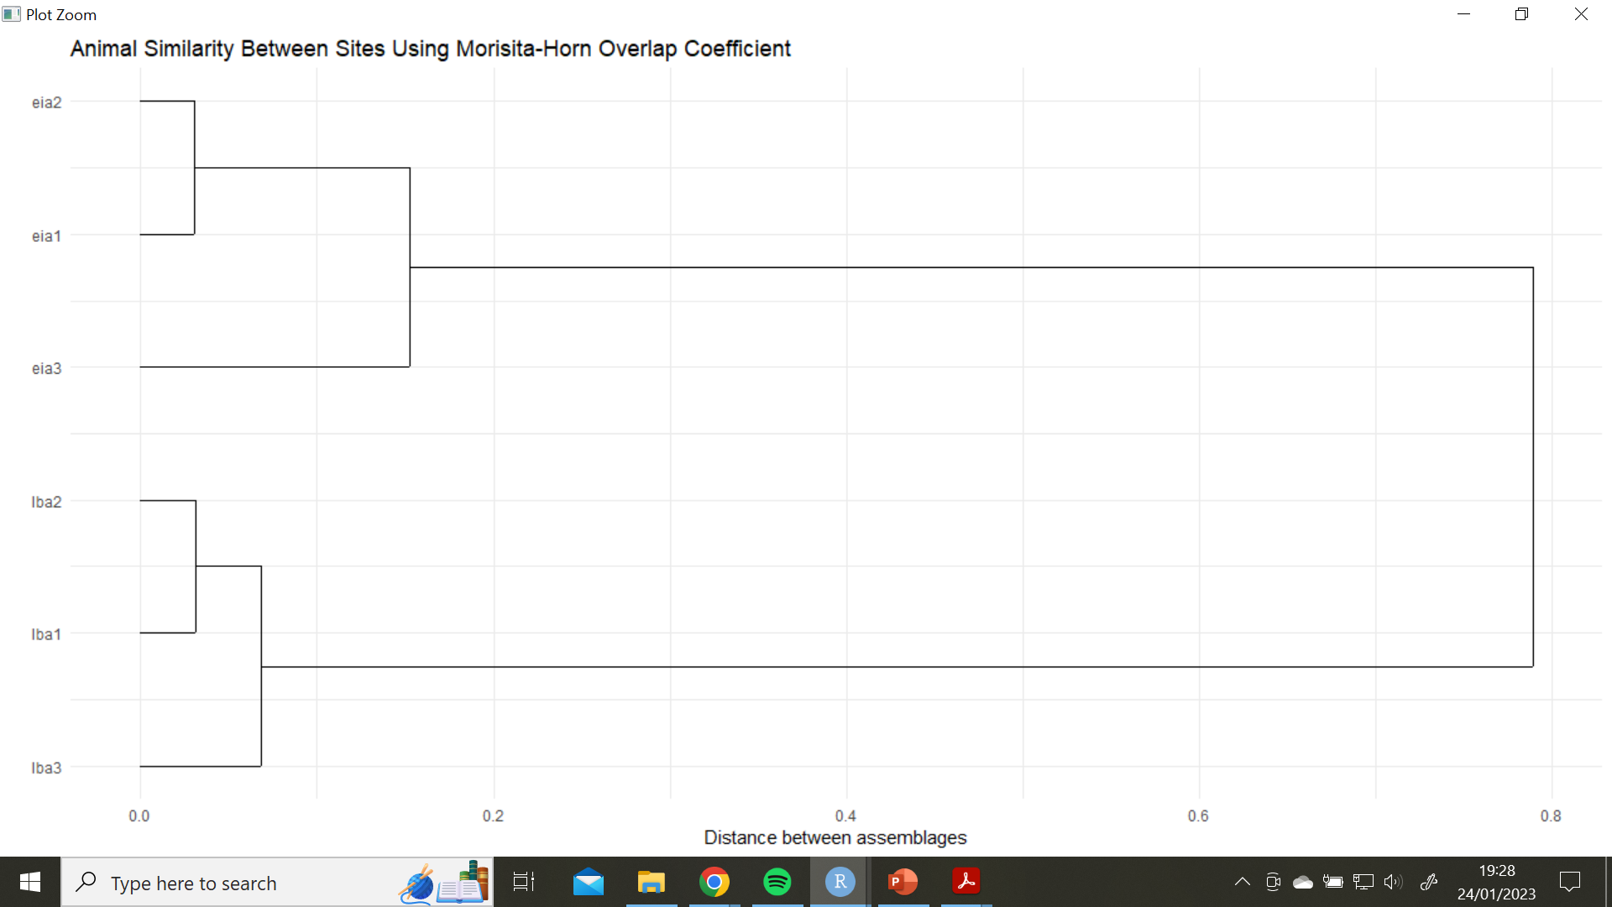
Visualizing Pairwise Distances: Exercise
Plotting the results as a dendrogram helps to better visualize the clusters and distances between them in the data.
Using the techniques you’ve learned today, could you make a dendrogram of the results for Jaccard’s Index, or a raster for the results of the Morisita-Horn Coefficient?
www.cdcs.ed.ac.uk

Slide 29
References
Correlation
https://www.statmethods.net/stats/correlations.html
https://en.wikipedia.org/wiki/Correlation_and_dependence
http://guessthecorrelation.com/
https://www.linkedin.com/learning/r-statistics-essential-training/calculating-correlation?autoplay=true&u=50251009
Coefficients of similarity diversity
https://cals.arizona.edu/classes/rnr555/lecnotes/10.html
https://geographyfieldwork.com/Simpson'sDiversityIndex.html
http://www.countrysideinfo.co.uk/simpsons.htm
https://cran.r-project.org/web/packages/vegan/vegan.pdf

Slide 30

Feedback
This series of trainings depend on annually allocated founds!!! To secure them we need to provide detailed feedback on them
https://edin.ac/33TwJxY

